Slide 2


E-COMMERCE WEBSITE
PHP-Project
Prepared by : Rojesh Humagain

Slide 3


Introduction
Ecommerce is the buying and selling of goods and services over the internet .
It is conducted over the computer , tablets, smart phones and other smart devices.
Almost anything can be purchased through ecommerce today for this reason ecommerce is often highly competitive.
Top examples of Ecommerce that have make it big Amazon Daraz ,Flipkart ,ebay ,Myntra etc.

Slide 4








Objective:
Save money & time
24/7 Support
Online Order
Happy Costumer
Special offer
Promotion

Slide 5
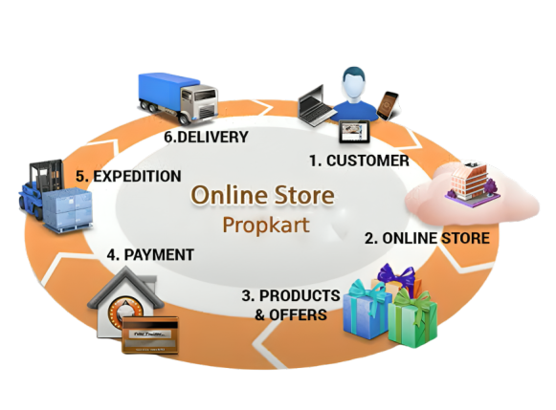
Process
Hamroखाचो

Slide 6
Features
Menu
Admin page
Product Catalog
User login/register/forgot password
Add to Cart
Increase or decrease product quantity and delete from cart.
Checkout & payment
Responsive For all devices
Database connection

Slide 7








Software requirements
Language:
HTML
CSS
Bootstrap
Java Script
PHP/Mysql(For Database Connection)
Tools:
Vs Code editor
Canva (logo design)
Adobe Photoshop

Slide 8
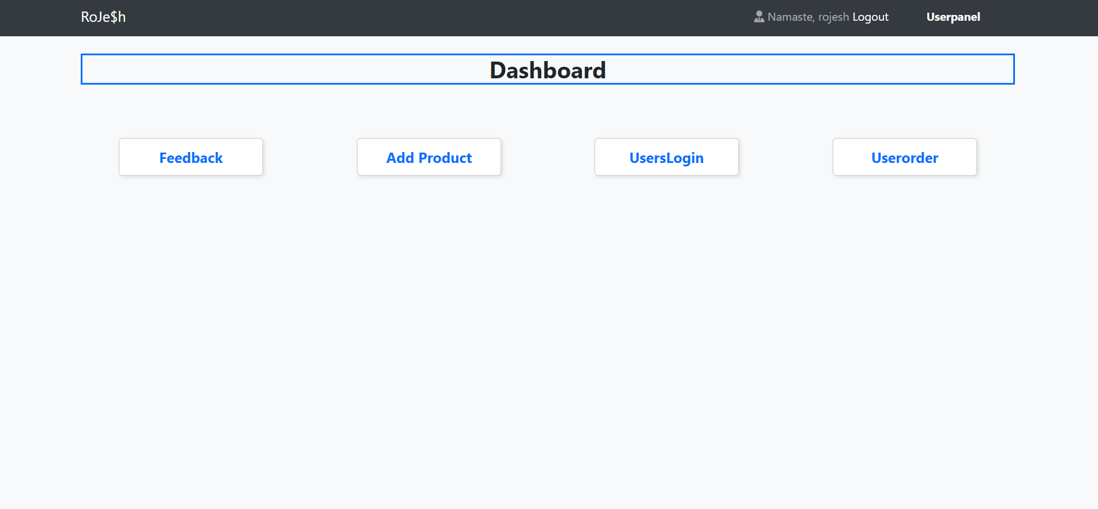
Admin Dashboard

Slide 9
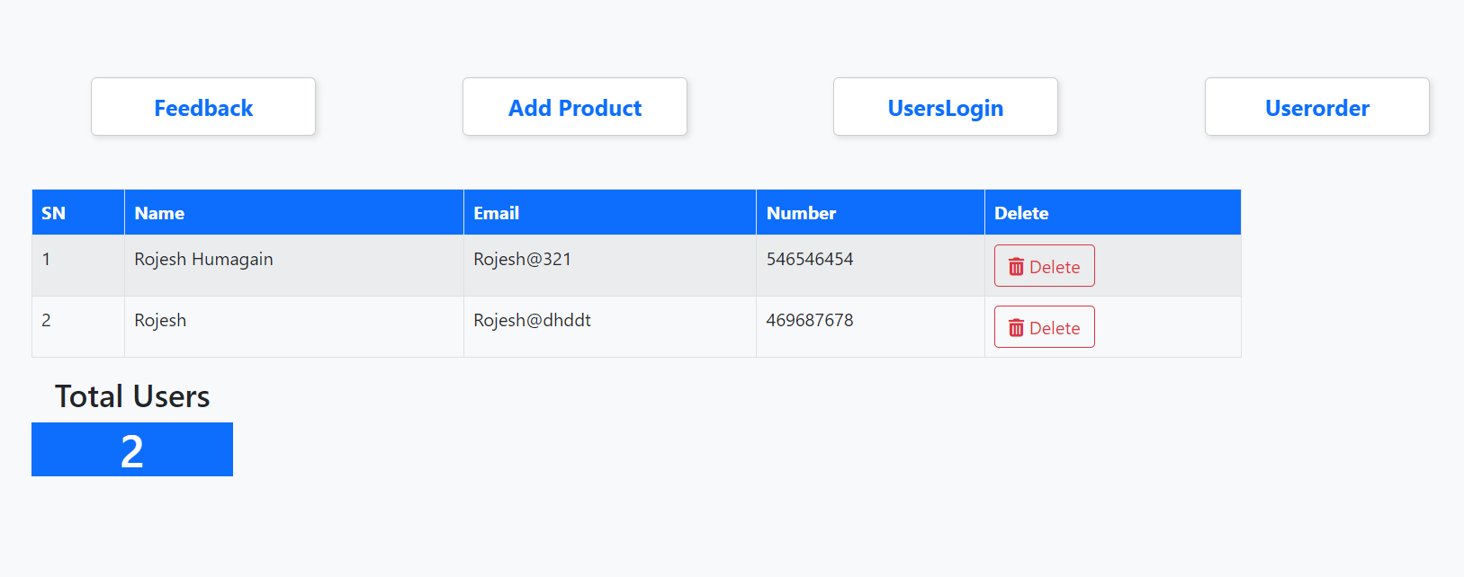
User login

Slide 10
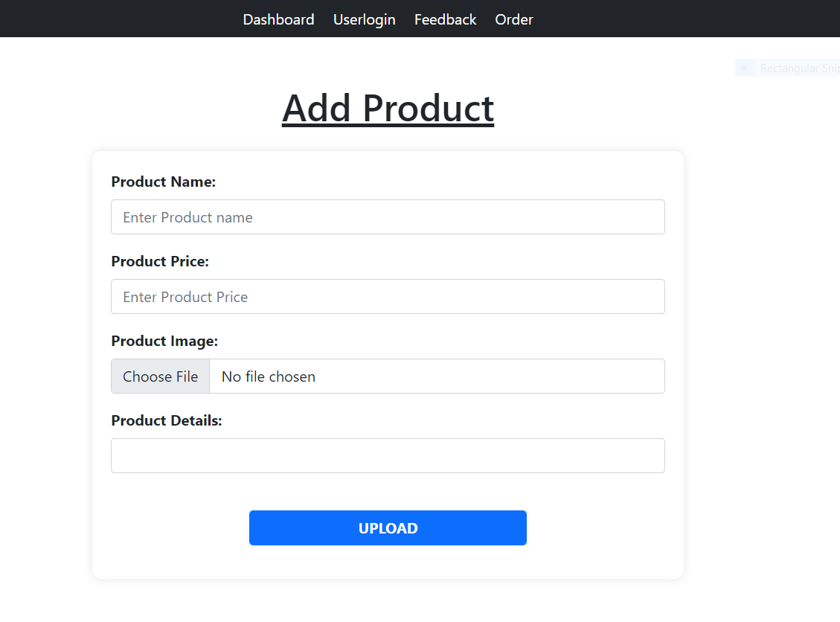
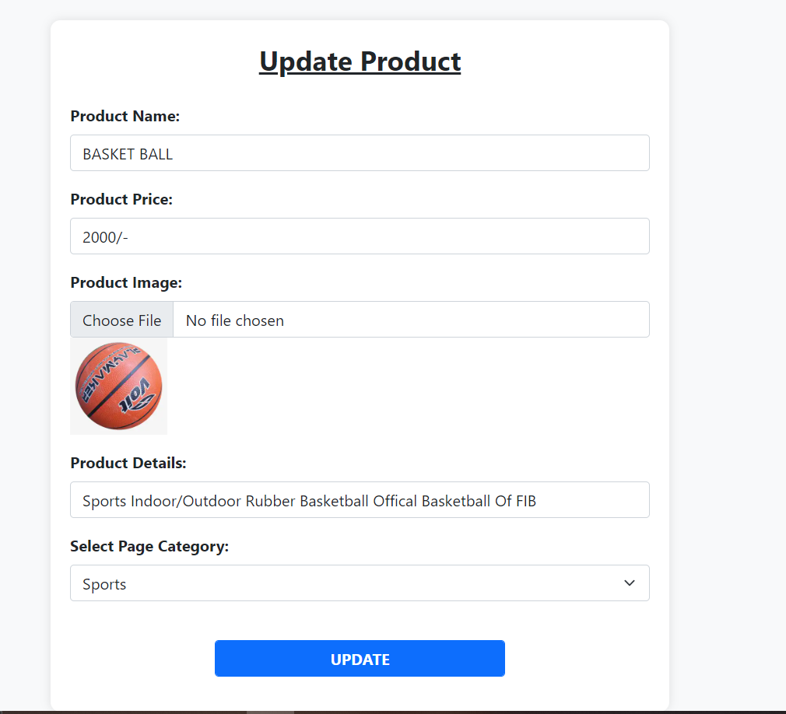
Add & Update Product

Slide 11
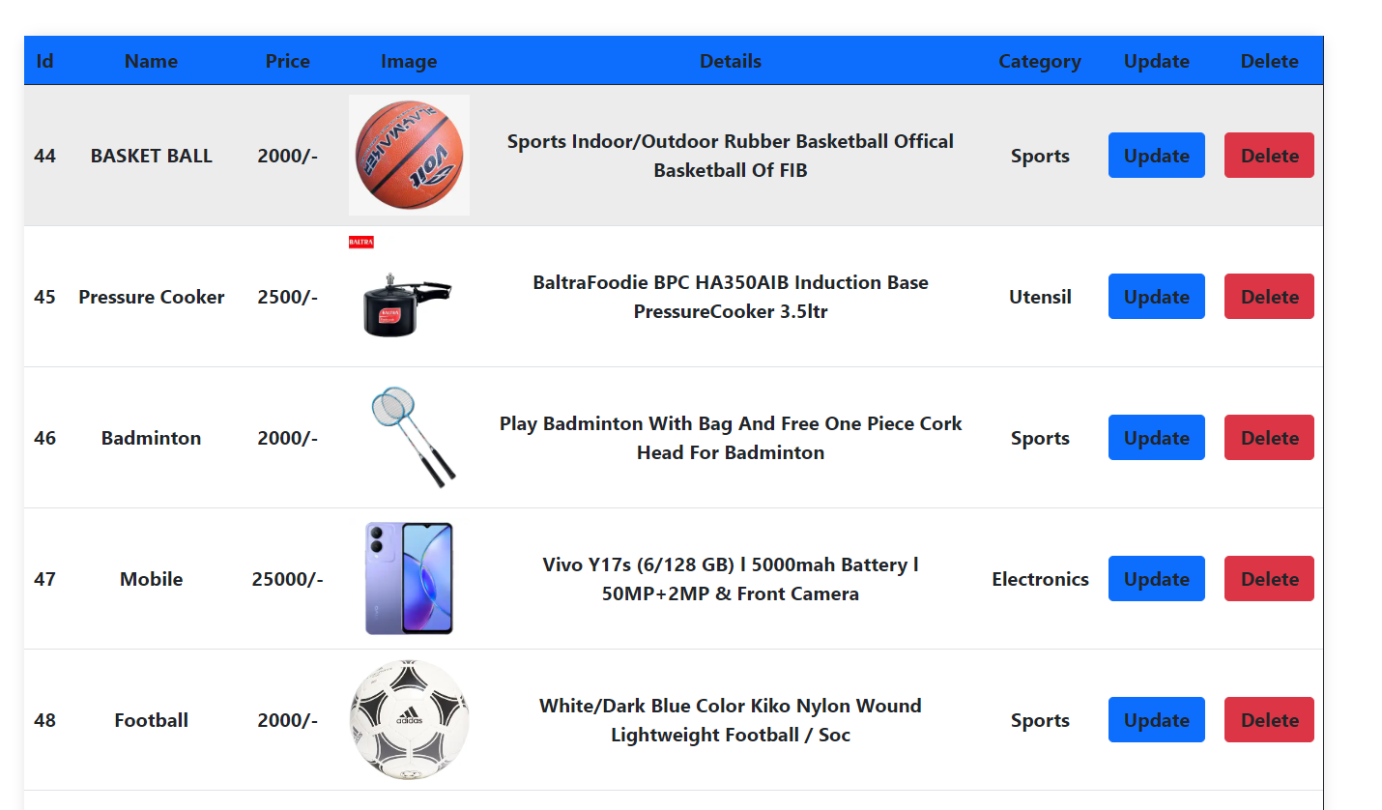
Product Table

Slide 12
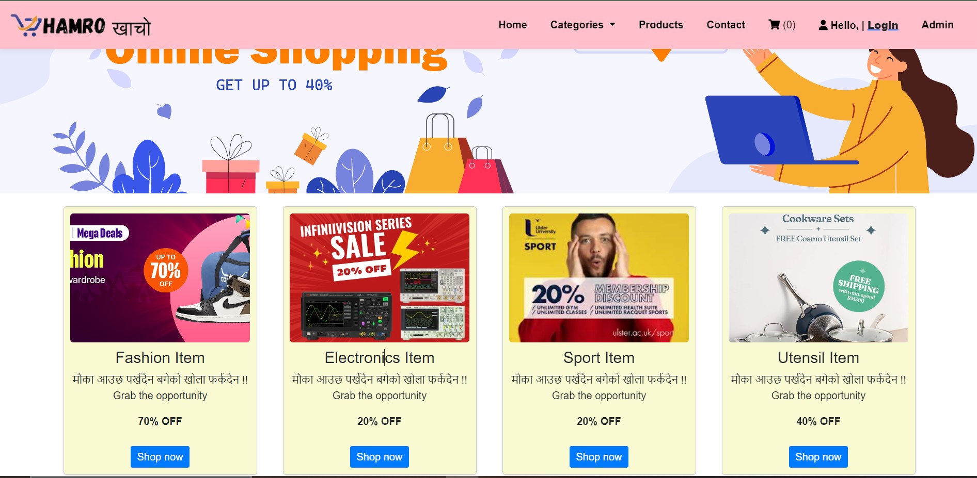
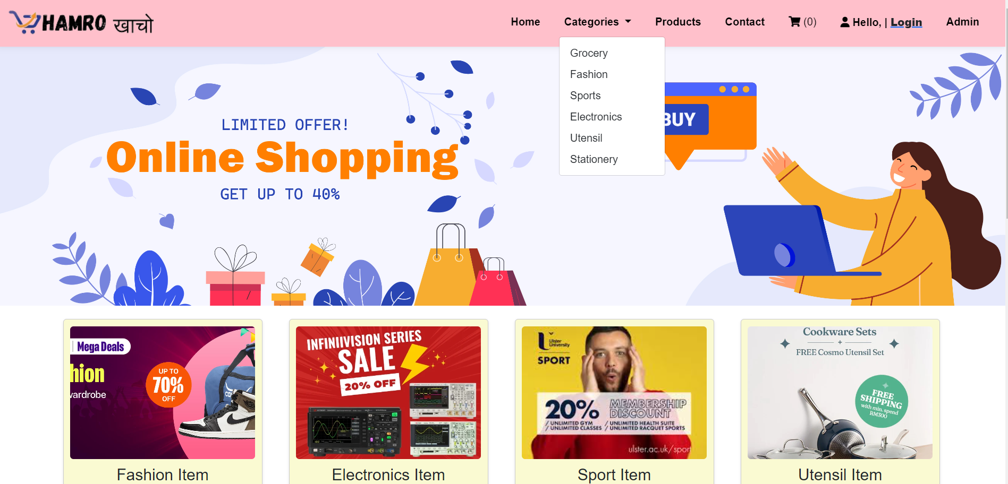

User Homepage
Categories

Slide 13
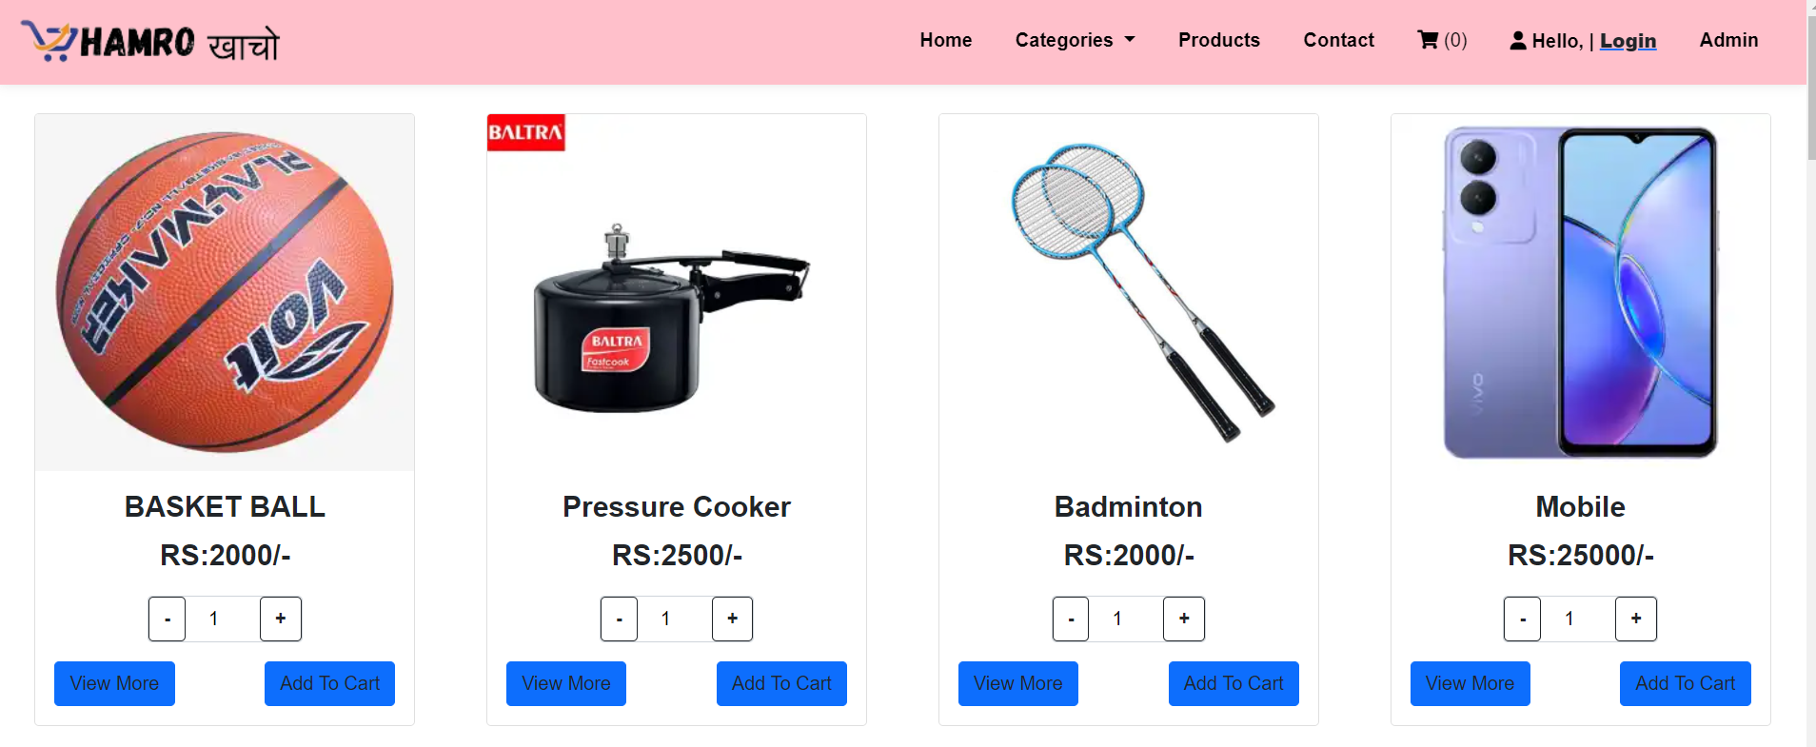
Product page

Slide 14
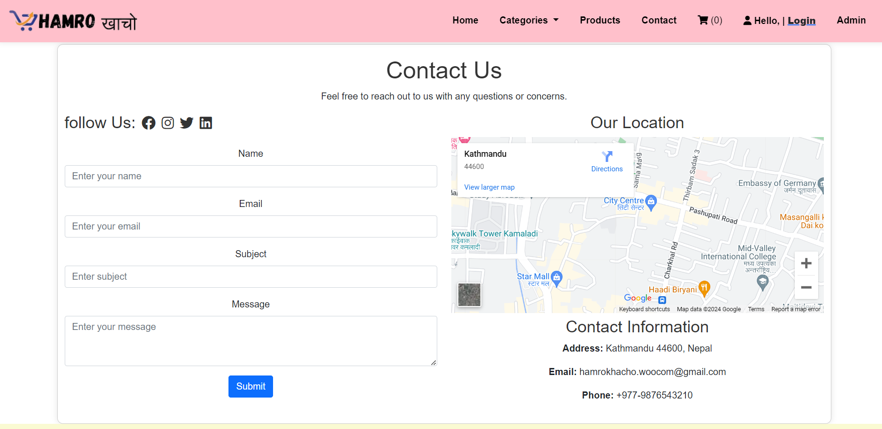
Contact page

Slide 15
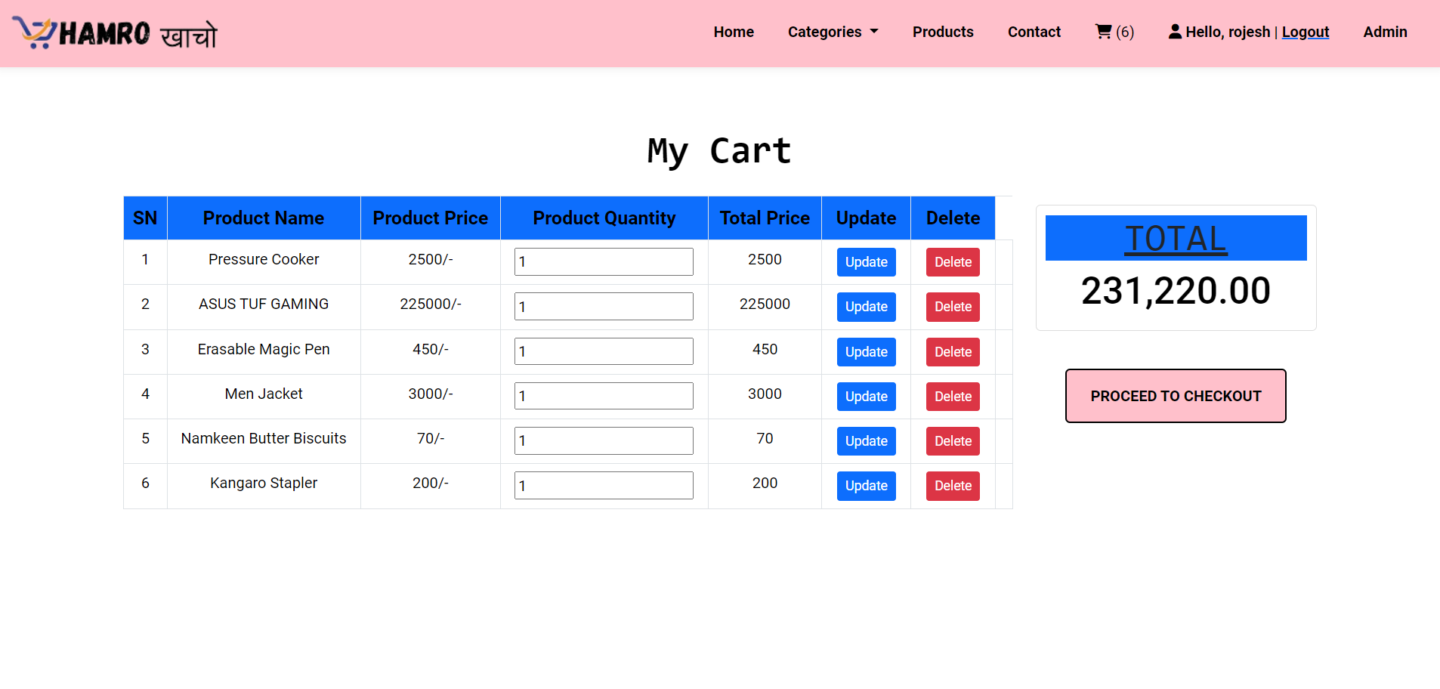
Cart page

Slide 16
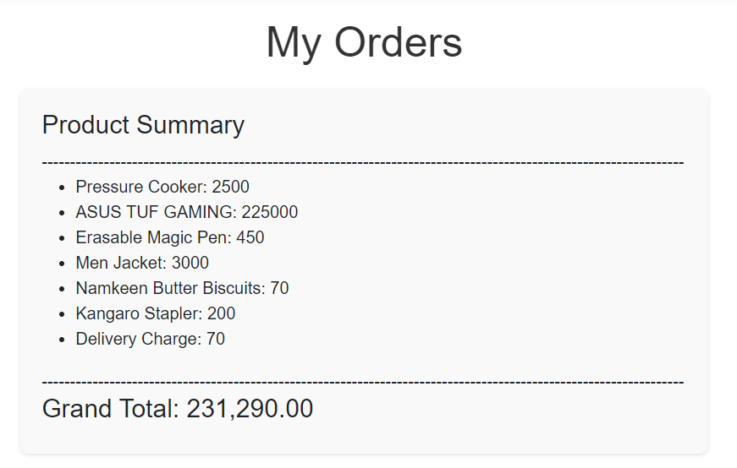
Order Form

Slide 17
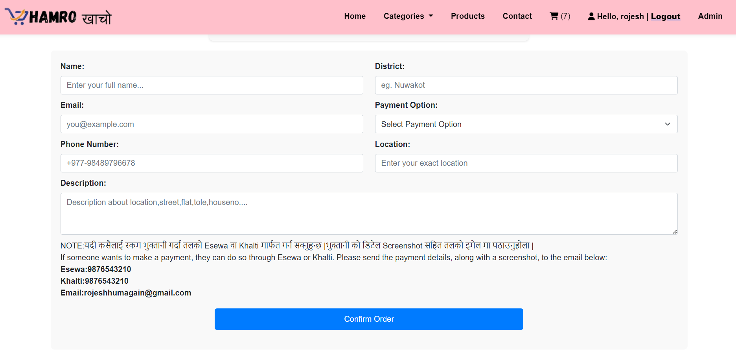
Order Form

Slide 18
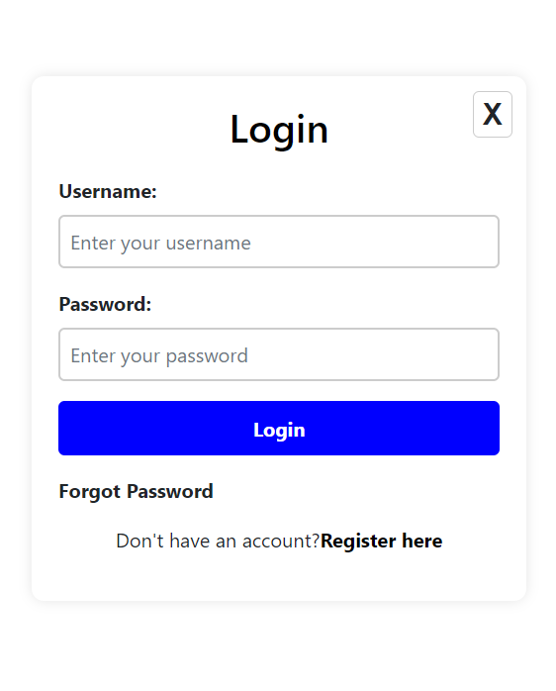
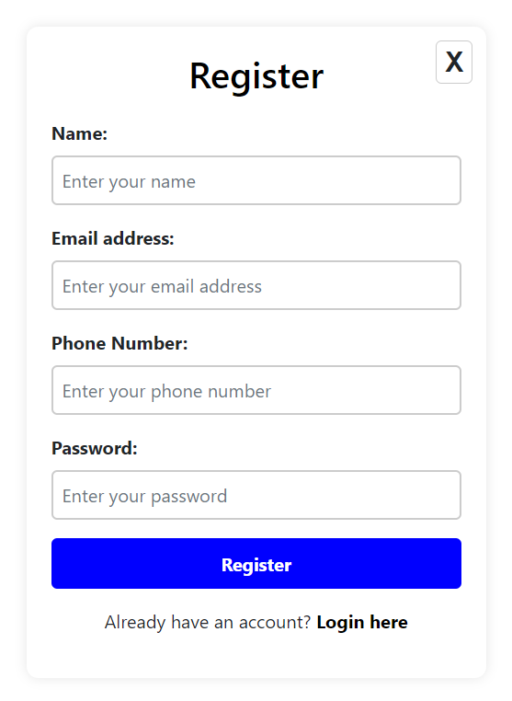
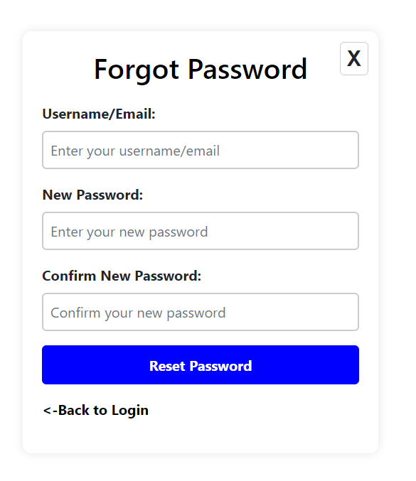
Login page
Register page
Forgot page

Slide 19
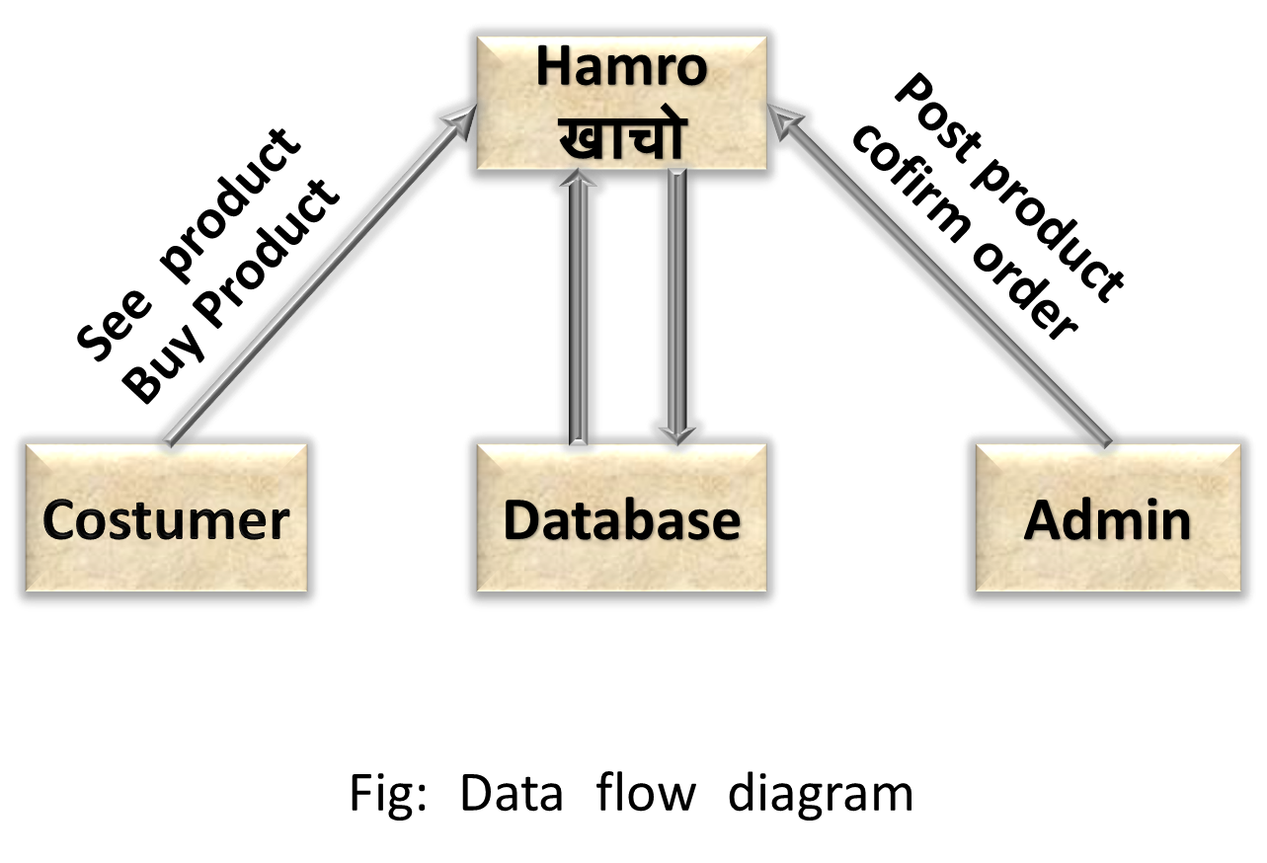
Data flow Diagram

Slide 20

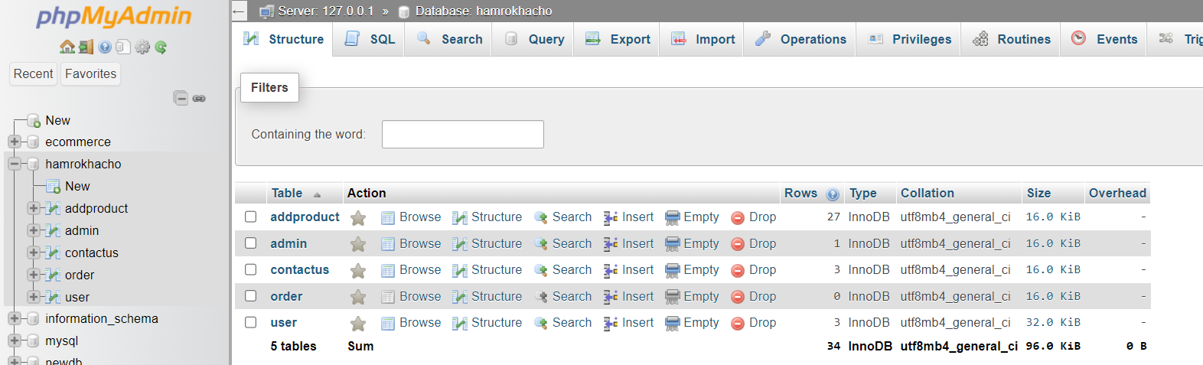
Database
Database Name
Database Table

Slide 21
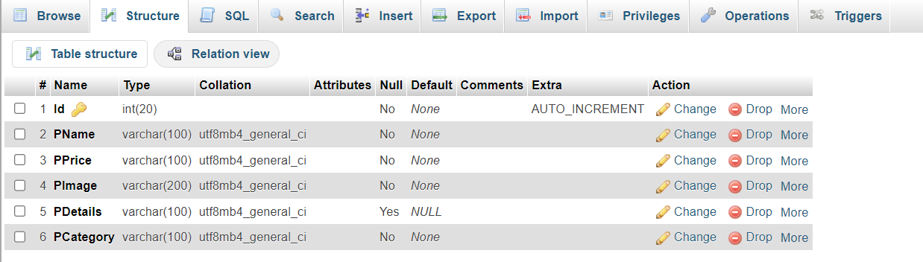
Addproduct table

Slide 22
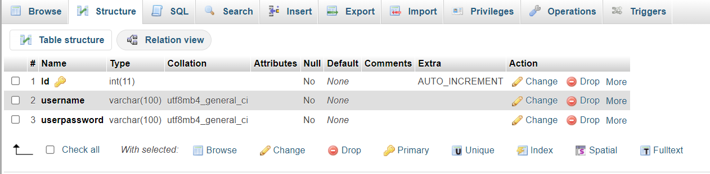
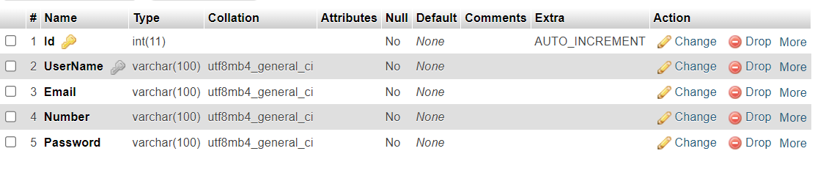
Admin & User table

Slide 23
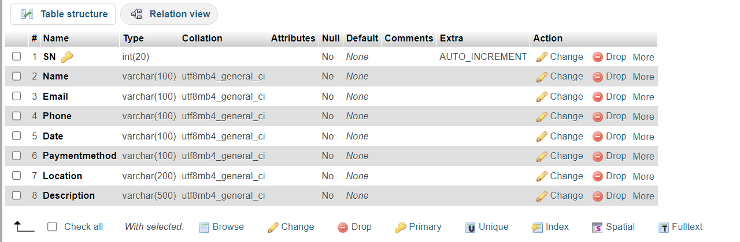
Order page

Slide 24
Thank - You

